Slide 1
CHAP 6 File System and I/O Management File Management:

Slide 2
Files
When you use an application to do work - e.g., write a paper, make a spreadsheet, or draw a picture, the work is stored in RAM first
It is in danger of being lost if the power goes off (RAM is volatile!)
When you save it, it is copied to a secondary storage device like the hard drive
It is saved as a FILE with a name, extension, time, date, size

Slide 3
File Names and Extensions
You must adhere to file-naming conventions when saving files
Case sensitivity – upper and lower case are different
True in Linux and Unix variations, not in Windows
Maximum length (Windows 260 characters)
Spaces allowed
Digits allowed
\ / : * ? " < > | not allowed
File extensions provide clues to the file contents

Slide 4
Filename Extensions
Filename extensions:
Used by programs
Indicate the file format
Extension | Type of Document | Application
.doc or .docx | Word processing document | Microsoft Word; Corel WordPerfect
.xls or .xlsx | Workbook | Microsoft Excel
.ppt or .pptx | PowerPoint presentation | Microsoft PowerPoint
.mdb or .accdb | Database | Microsoft Access
.bmp | Bitmap image | Windows
.zip | Compressed file | WinZip
.pdf | Portable Document Format | Adobe Acrobat
.htm or .html | Web page | Hypertext Markup Language

Slide 5
How to Make Extensions Visible in Windows
Windows default is NOT to show the common extensions of filenames but we want to SEE them!
Open a Windows Explorer window
Choose Organize tab
Choose Folder and search options
Choose View tab
UNcheck the box that says “Hide extensions for known file types”
Choose “Apply to Folders”
(Win 10) https://www.thewindowsclub.com/show-file-extensions-in-windows

Slide 6
File Systems – Drives
Every Computer has a File System used to keep track of the files on that machine
File Systems are based on Physical Storage Devices, known as Drives
Drives can be local or remote (network or cloud)
Click on “My Computer” to see a list of drives (on a Windows machine)

Slide 7
File Systems – Drives
Typical Drives
A: or B: → Floppy Disk
C: → Local Hard Drive
D: → CD Drive
E-Z for removable drives like memory sticks
About any letter for a partition of a device
WATCH OUT for the D drive on lab machines! It is another hard drive that is not erased when you log out! Do not leave your work on there!

Slide 8
File Systems – Partitions
Note that a “partition” is not a physical device, although it looks like one to the OS.
Why have a partition? At one point Windows could only handle devices of a certain size. If your hard drive was larger than that size, you could not access the entire device. Partitions fool the OS into thinking that one device is two (or more!) devices, each with their own letter and file system
You will find disks partitioned even today, when some space is used for a specific need, like a backup

Slide 9
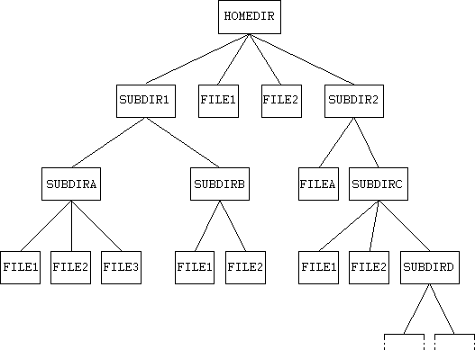
File System on a Device

Slide 10
File Organization and access
Types of Access:
The need to protect files is a direct result of the ability to access files. Systems that do not permit access to the files of other users do not need protection.
Thus, we could provide complete protection by prohibiting access. Alternatively, we could provide free access with no protection. Both approaches are too extreme for general use. What is needed is controlled access. Protection mechanisms provide controlled access by limiting the types of file access that can be made.
Access is permitted or denied depending on several factors, one of which is the type of access requested. Several different types of operations may be controlled:
• Read. Read from the file.
• Write. Write or rewrite the file.
• Execute. Load the file into memory and execute it.
• Append. Write new information at the end of the file.
• Delete. Delete the file and free its space for possible reuse.
• List. List the name and attributes of the file.

Slide 11
Other operations, such as renaming, copying, and editing the file, may also be controlled. For many systems, however, these higher-level functions may be implemented by a system program that makes lower-level system calls. Protection is provided at only the lower level.
For instance, copying a file may be implemented simply by a sequence of read requests. In this case, a user with read access can also cause the file to be copied, printed, and so on. Many protection mechanisms have been proposed. Each has advantages and disadvantages and must be appropriate for its intended application. A small computer system that is used by only a few members of a research group, for example, may not need the same types of protection as a large corporate computer that is used for research, finance, and personnel operations.

Slide 12
Access Control
The most common approach to the protection problem is to make access dependent on the identity of the user. Different users may need different types of access to a file or directory. The most general scheme to implement identity dependent access is to associate with each file and directory an access-control list (ACL) specifying user names and the types of access allowed for each user. When a user requests access to a particular file, the operating system checks the access list associated with that file. If that user is listed for the requested access, the access is allowed. Otherwise, a protection violation occurs, and the user job is denied access to the file. The main problem with access lists is their length. If we want to allow everyone to read a file, we must list all users with read access. This technique has two undesirable consequences:
• Constructing such a list may be a tedious and unrewarding task, especially if we do not know in advance the list of users in the system.
• The directory entry, previously of fixed size, now must be of variable size, resulting in more complicated space management.
These problems can be resolved by use of a condensed version of the access list. To condense the length of the access-control list, many systems recognize three classifications of users in connection with each file:
• Owner. The user who created the file is the owner.
• Group. A set of users who are sharing the file and need similar access is a group, or work group.
• Universe. All other users in the system constitute the universe.

Slide 13
File Directories and Folders
Every storage device has a directory containing a list of its files
Root directory (like “C:\”)
Subdirectory
Depicted as folders
A computer’s file location is defined by a file specification, or path
Examples: D:\ is the root of the D drive
Examples: C:\Notes\CS 101\Week 1\notes.txt
Examples: F:\1999\Music\CDs\Prince\

Slide 14

Methods for File Directory Structure :
Single- Level Directory Systems:
It is the simplest directory structure , where one directory contains all files.
This single directory is called root directory .
Five files by 3 different users P, Q , & R .User P has 2 Files, User Q has 2 Files, & R has 1 file in directory.

Slide 15
Advantages: Simple to implement
Locating files become faster .
Limitations : If single user has huge number of files kept in single directory , it becomes difficult to rename name of each file.
Different users give same name to files , which violates the rule of uniqueness of names .

Slide 16
Two – Level Directory System :
In the two-level directory structure, each user has his own user file directory (UFD). The UFDs have similar structures, but each lists only the files of a single user. When a user job starts or a user logs in, the system’s master file directory (MFD) is searched.
When a user refers to a particular file, only his own UFD is searched. Thus, different users may have files with the same name, as long as all the file names within each UFD are unique. To create a file for a user, the operating system searches only that user’s UFD to ascertain whether another file of that name exists. To delete a file, the operating system confines its search to the local UFD; thus, it cannot accidentally delete another user’s file that has the same name.

Slide 17
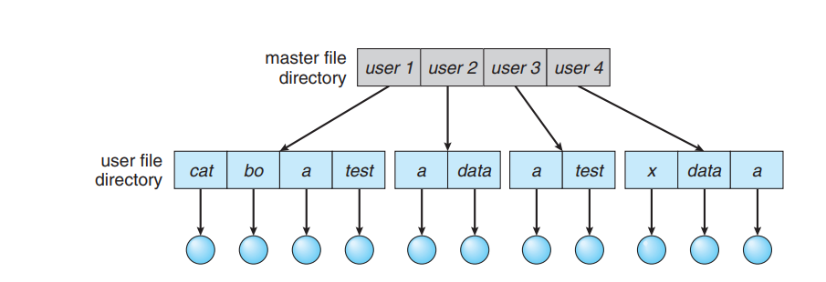
Advantages : Solves name collision problem as every user has its own directories.
Independent user gets isolated from each other .
Limitations :
To name a particular file , we must give both user name & file name .
It is not satisfactory for users with large number of files.

Slide 18
Hierarchical Directory Systems :
A tree is the most common directory structure. The tree has a root directory, and every file in the system has a unique path name. A directory (or subdirectory) contains a set of files or subdirectories. A directory is simply another file, but it is treated in a special way. All directories have the same internal format.
One bit in each directory entry defines the entry as a file (0) or as a subdirectory (1). Special system calls are used to create and delete directories. In normal use, each process has a current directory. The current directory should contain most of the files that are of current interest to the process. When reference is made to a file, the current directory is searched.

Slide 19
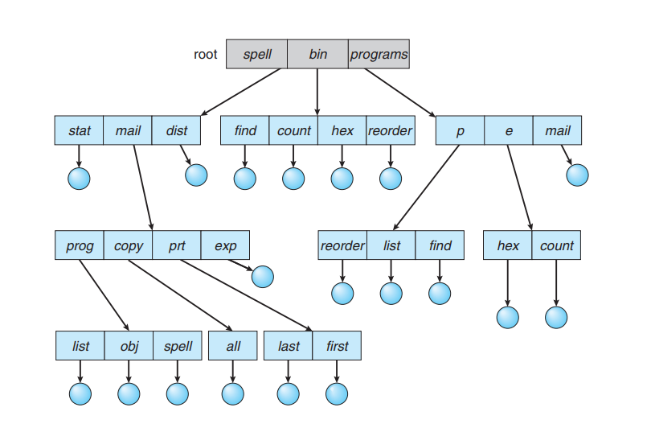
Advantages : Users can also access the files of others users by specifying its pathname.

Slide 20
File Formats
A file format refers to the organization and layout of data that is stored in a file
A file extension usually indicates the format of a file and the application which was used to create the file
But it does not have to! Just changing the extension on a file from xlsx to zip does not make the file a zip file! It needs to be converted from a spreadsheet to a zipped file using the zip application.

Slide 21
Applications and Files
Most applications that create files have a file menu
Choices will include Save and Save As
Save saves on same filename, if has been saved once already
Save asks for new name if has not been saved before
Save As asks for new name and saves new copy of file
Duplicate – makes another copy with new name but you keep editing old version
Rename – allows you to change the name of the current file

Slide 22
File Management
The operating system provides an organizational structure to the computer’s data and programs
Hierarchical structure of directories:
Drives
Folders
and more Folders …
Files
Storage metaphors help you visualize and mentally organize the files on your disks and other storage devices
Notes:
An additional function of the OS is to enable file management, which entails providing organizational structure to the computer’s contents. The OS allows you to organize the contents of your computer in a hierarchical structure of directories that includes drives, folders, subfolders, and files.
.

Slide 23
Allocation Methods
Contiguous allocation
Linked List allocation
Indexed allocation
I nodes

Slide 24
1. Contiguous Allocation
Each file occupies a set of contiguous blocks on the disk.
Simple: only starting location (block #) and length (number of blocks) required.
Enables random access.
Wasteful of space (dynamic storage-allocation problem).
Files cannot grow.

Slide 25
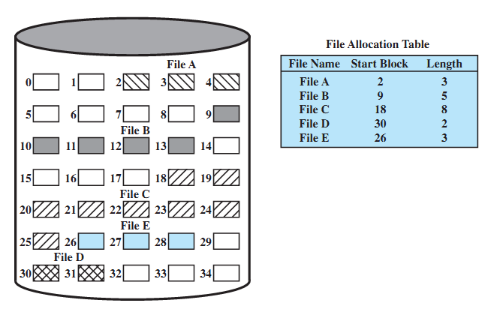
Contiguous File Allocation Example

Slide 26
2. Linked List Allocation
Each file is a linked list of disk blocks: blocks may be scattered anywhere on the disk.
Simple: need only starting address.
Free-space management: no waste of space.
No random access.
block =
pointer

Slide 27
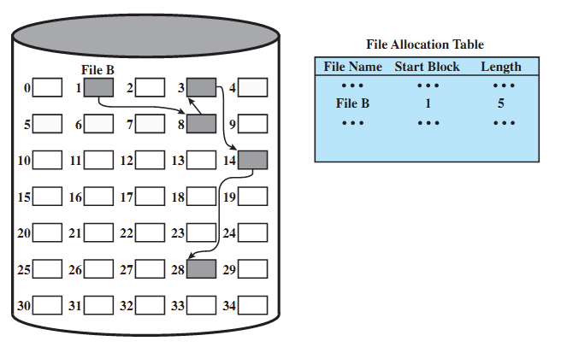
Linked List Allocation Example

Slide 28
3. Linked List Allocation Using a Table in Memory
Each block needs a pointer information, due to this entire block is not fully utilised to store data.
To avoid the problem pointer information can be stored in table.

Slide 29
Linked List Allocation Using a Table in Memory

Slide 30
4. Indexed Allocation (I node)
Brings all pointers together into the index block.
It’s a logical view.
Need index table.
Provides random access.
Dynamic access without external fragmentation, but have overhead of index block.
index table

Slide 31
Input /Output Management
I/O Management and Disk Scheduling: I/O Devices, I/O Buffering, Disk Scheduling algorithm: FCFS, SSTF, SCAN, CSCAN, LOOK, C-LOOK. RAID

Slide 32
Input and Output Devices
An input/output device, often known as an IO device, is any hardware that allows a human operator or other systems to interface with a computer. Input/output devices, as the name implies, are capable of delivering data (output) to and receiving data from a computer (input). An input/output (I/O) device is a piece of hardware that can take, output, or process data. It receives data as input and provides it to a computer, as well as sends computer data to storage media as a storage output.

Slide 33
Input Devices
Input devices are the devices that are used to send signals to the computer for performing tasks. The receiver at the end is the CPU (Central Processing Unit), which has work to send signals to the output devices. Some of the classifications of Input devices are:
Keyboard Devices
Pointing Devices
Composite Devices
Game Controller
Visual Devices
Audio Input Devices

Slide 34
Output Devices
Output Devices are the devices that show us the result after giving the input to a computer system. Output can be of many different forms like image, graphic audio, video, etc.

Slide 35
I/O Buffering,
A buffer is a memory area that stores data being transferred between two devices or between a device and an application.

Slide 36
Uses of I/O Buffering :
Buffering is done to deal effectively with a speed mismatch between the producer and consumer of the data stream.
A buffer is produced in main memory to heap up the bytes received from modem.
After receiving the data in the buffer, the data get transferred to disk from buffer in a single operation.
This process of data transfer is not instantaneous, therefore the modem needs another buffer in order to store additional incoming data.
When the first buffer got filled, then it is requested to transfer the data to disk.
The modem then starts filling the additional incoming data in the second buffer while the data in the first buffer getting transferred to disk.
Buffering also provides variations for devices that have different data transfer sizes.

Slide 37
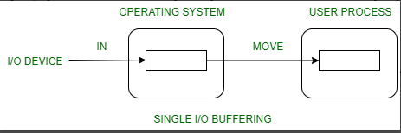
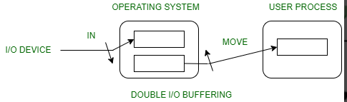
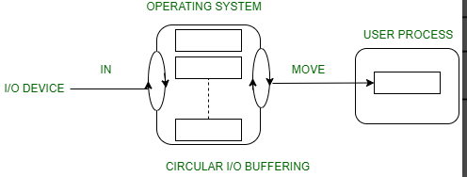
Types of various I/O buffering techniques :
1. Single buffer :
2. Double buffer :
3. Circular buffer :

Slide 38
Disk Scheduling algorithm: FCFS, SSTF, SCAN, CSCAN, LOOK, C-LOOK. RAID
FCFS (First Come First Serve)
FCFS is the simplest of all Disk Scheduling Algorithms. In FCFS, the requests are addressed in the order they arrive in the disk queue.
Example:
Suppose the order of request is- (82,170,43,140,24,16,190) And current position of Read/Write head is: 50 (solved in class )

Slide 39
Advantages of FCFS
Here are some of the advantages of First Come First Serve.
Every request gets a fair chance
No indefinite postponement
Disadvantages of FCFS
Here are some of the disadvantages of First Come First Serve.
Does not try to optimize seek time
May not provide the best possible service

Slide 40
SSTF (Shortest Seek Time First)
In SSTF (Shortest Seek Time First), requests having the shortest seek time are executed first. So, the seek time of every request is calculated in advance in the queue and then they are scheduled according to their calculated seek time. As a result, the request near the disk arm will get executed first. SSTF is certainly an improvement over FCFS as it decreases the average response time and increases the throughput of the system
Suppose the order of request is- (82,170,43,140,24,16,190) And current position of Read/Write head is: 50 (solved in class)

Slide 41
Advantages of Shortest Seek Time First
Here are some of the advantages of Shortest Seek Time First.
The average Response Time decreases
Throughput increases
Disadvantages of Shortest Seek Time First
Here are some of the disadvantages of Shortest Seek Time First.
Overhead to calculate seek time in advance
Can cause Starvation for a request if it has a higher seek time as compared to incoming requests
The high variance of response time as SSTF favors only some requests

Slide 42
SCAN
In the SCAN algorithm the disk arm moves in a particular direction and services the requests coming in its path and after reaching the end of the disk, it reverses its direction and again services the request arriving in its path. So, this algorithm works as an elevator and is hence also known as an elevator algorithm. As a result, the requests at the midrange are serviced more and those arriving behind the disk arm will have to wait.
Suppose the requests to be addressed are-82,170,43,140,24,16,190. And the Read/Write arm is at 50, and it is also given that the disk arm should move “towards the larger value”.

Slide 43
Advantages of SCAN Algorithm
Here are some of the advantages of the SCAN Algorithm.
High throughput
Low variance of response time
Average response time
Disadvantages of SCAN Algorithm
Here are some of the disadvantages of the SCAN Algorithm.
Long waiting time for requests for locations just visited by disk arm

Slide 44
C-SCAN
In the SCAN algorithm, the disk arm again scans the path that has been scanned, after reversing its direction. So, it may be possible that too many requests are waiting at the other end or there may be zero or few requests pending at the scanned area.
These situations are avoided in the CSCAN algorithm in which the disk arm instead of reversing its direction goes to the other end of the disk and starts servicing the requests from there. So, the disk arm moves in a circular fashion and this algorithm is also similar to the SCAN algorithm hence it is known as C-SCAN (Circular SCAN).
Suppose the requests to be addressed are-82,170,43,140,24,16,190. And the Read/Write arm is at 50, and it is also given that the disk arm should move “towards the larger value”.

Slide 45
Advantages of C-SCAN Algorithm
Here are some of the advantages of C-SCAN.
Provides more uniform wait time compared to SCAN.

Slide 46
LOOK
LOOK Algorithm is similar to the SCAN disk scheduling algorithm except for the difference that the disk arm in spite of going to the end of the disk goes only to the last request to be serviced in front of the head and then reverses its direction from there only. Thus it prevents the extra delay which occurred due to unnecessary traversal to the end of the disk.
uppose the requests to be addressed are-82,170,43,140,24,16,190. And the Read/Write arm is at 50, and it is also given that the disk arm should move “towards the larger value”.

Slide 47
C-LOOK
As LOOK is similar to the SCAN algorithm, in a similar way, C-LOOK is similar to the CSCAN disk scheduling algorithm. In CLOOK, the disk arm in spite of going to the end goes only to the last request to be serviced in front of the head and then from there goes to the other end’s last request. Thus, it also prevents the extra delay which occurred due to unnecessary traversal to the end of the disk
Suppose the requests to be addressed are-82,170,43,140,24,16,190. And the Read/Write arm is at 50, and it is also given that the disk arm should move “towards the larger value”

Slide 48
RSS (Random Scheduling)
It stands for Random Scheduling and just like its name it is natural. It is used in situations where scheduling involves random attributes such as random processing time, random due dates, random weights, and stochastic machine breakdowns this algorithm sits perfectly. Which is why it is usually used for analysis and simulation.

